Slide 1
e-School
Mustafa BATTALOĞLU - 180709060
Enes DERTLİ - 180709012
Mehmet Kadri GOFRALILAR - 180709005
Hasan Ali ÖZKAN – 180709020

Slide 2
What is the issue?
The systems that are being used today are not sufficient. For example:
People are spending too much time on paperwork.
Also due to the big amount of paperwork, there is too much waste of paper
There are mix-ups about grading, absence and etc.

Slide 3
Solution
With this project, people will spend less time with paperwork, waste less paper, and finally, there won’t be too many mix-ups as before. Target group will be students, lecturers and student affairs personnel.
e-School will be an all-in-one system. We will merge the current Learning Management System and Student Information System. Also we will add new features.
LMS has features like uploading and accessing course materials, assigning and submitting assignments.
SIS has features like course registration, grading, checking grades, adding students, lecturers, and lectures to the system.
New features will be added like digital attendance and sending group messages to whole class.

Slide 4
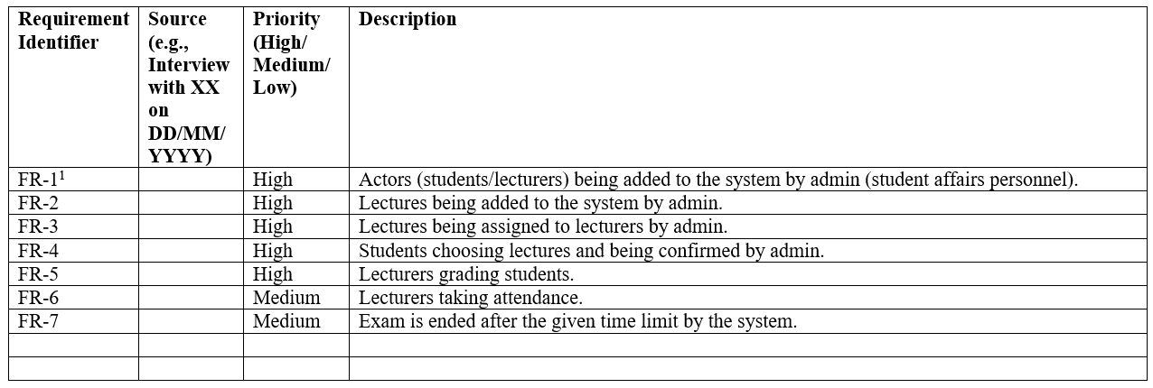
Functional Requirements

Slide 5
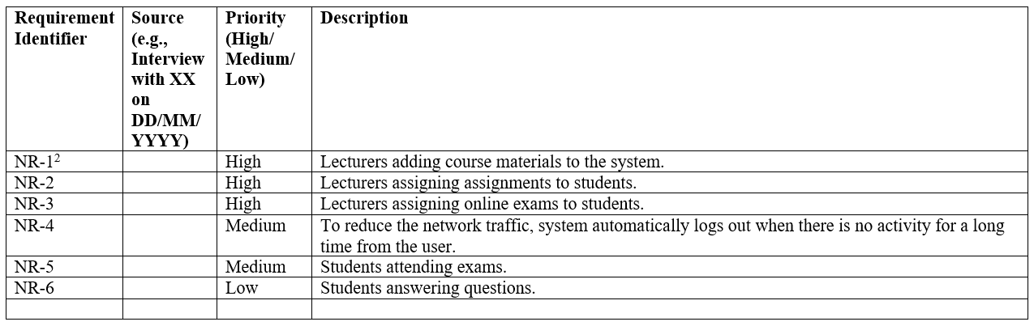
Nonfunctional Requirements

Slide 6
Actors and Roles
Students
Lecturer
Student Affairs Personnel

Slide 7
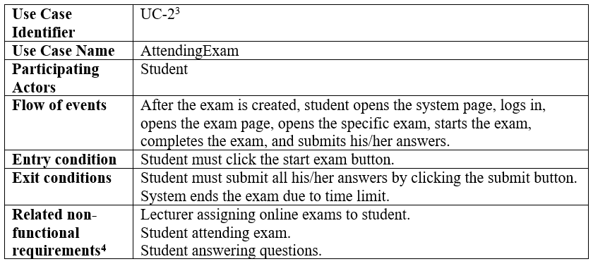
Use Case

Slide 8
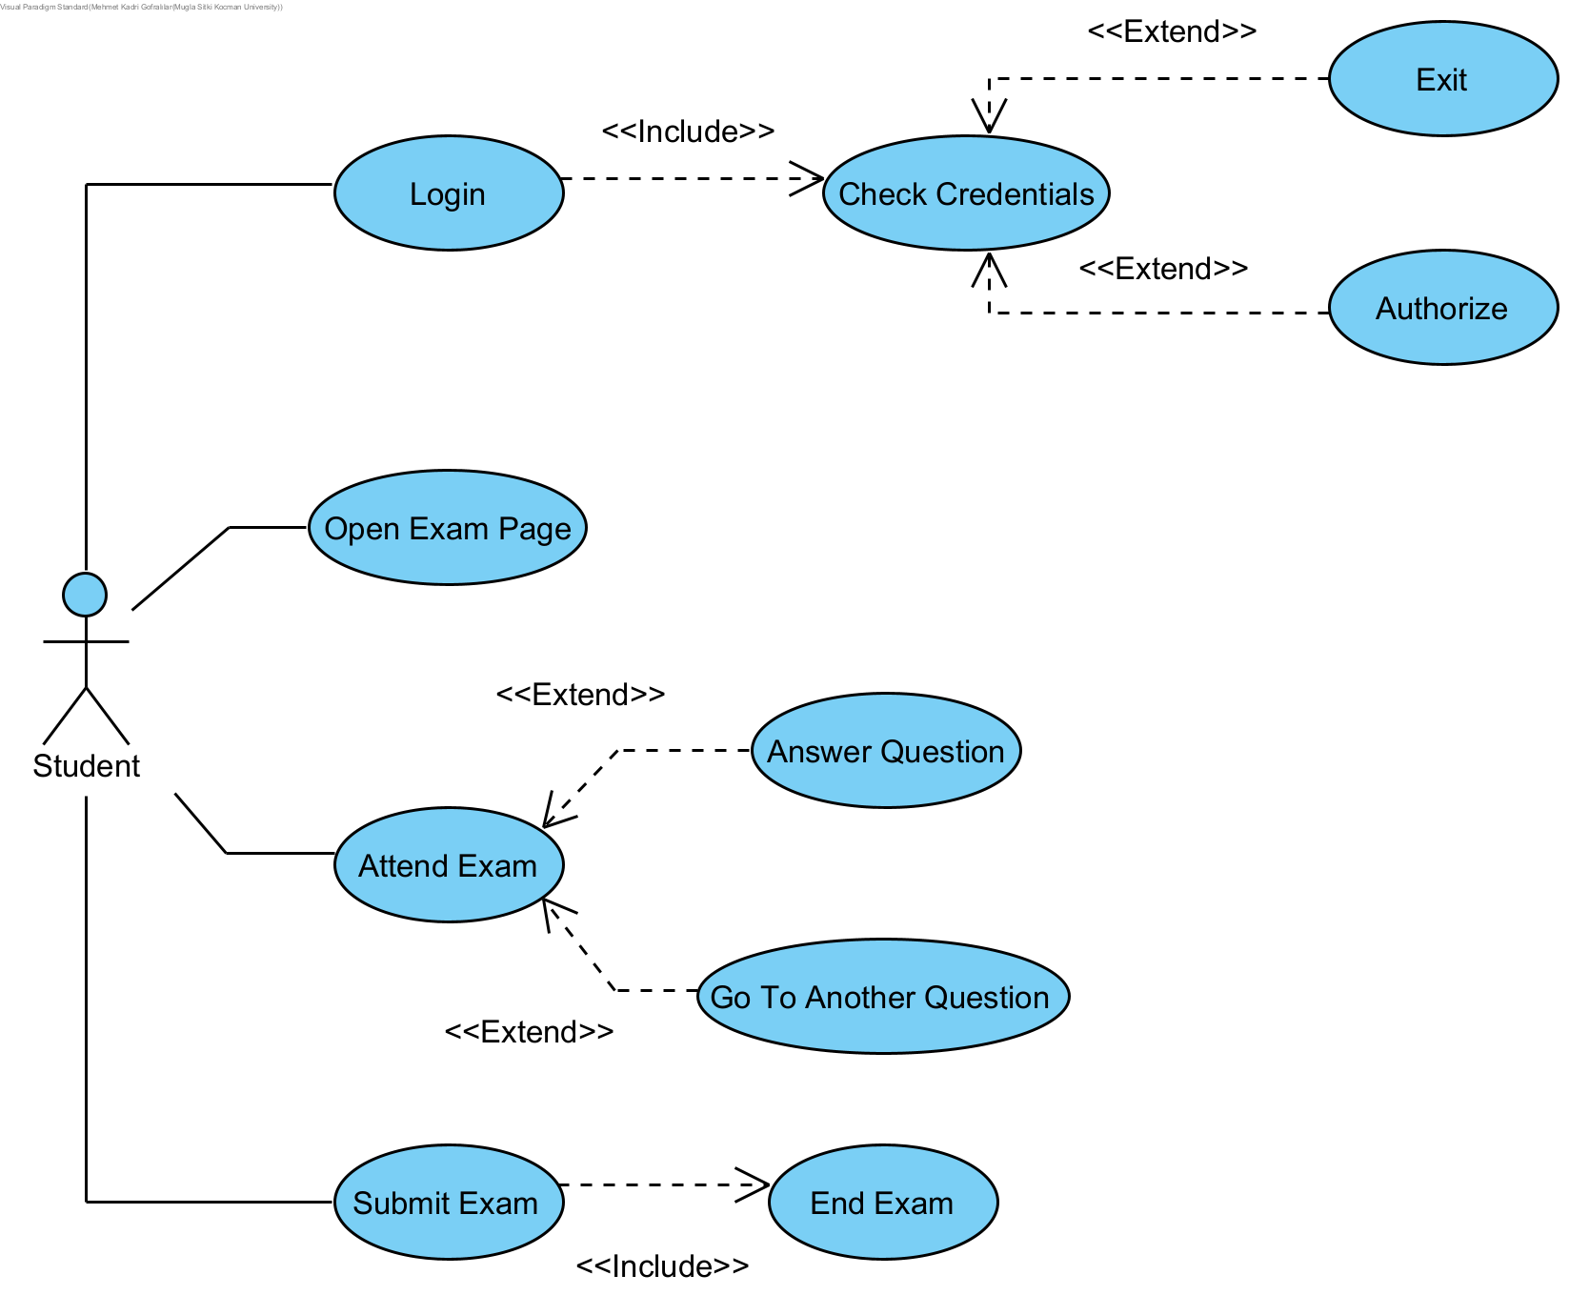
Use Case Diagram

Slide 9
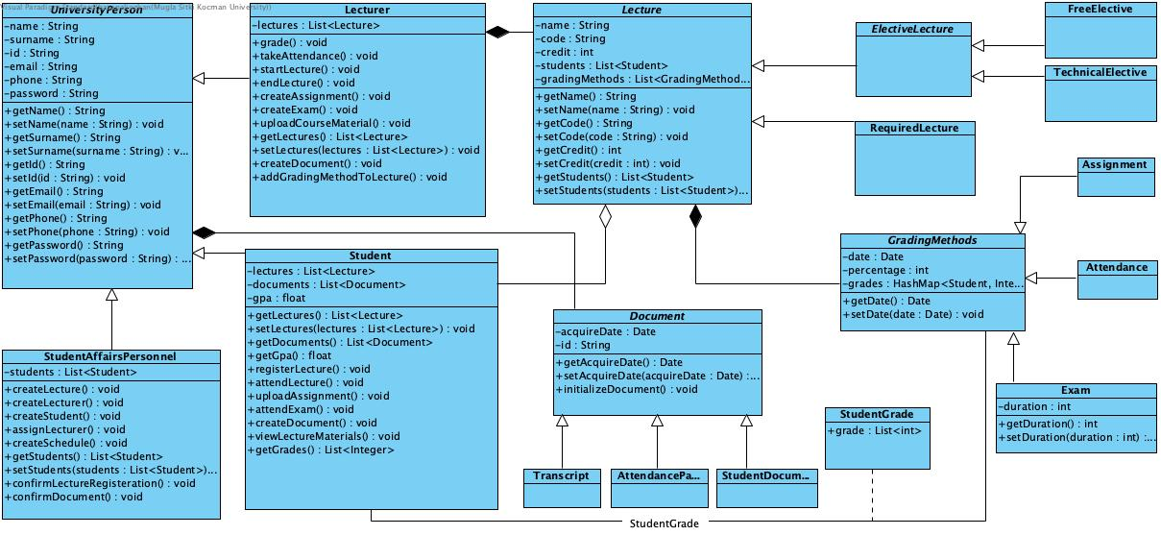
Class Diagram

Slide 10
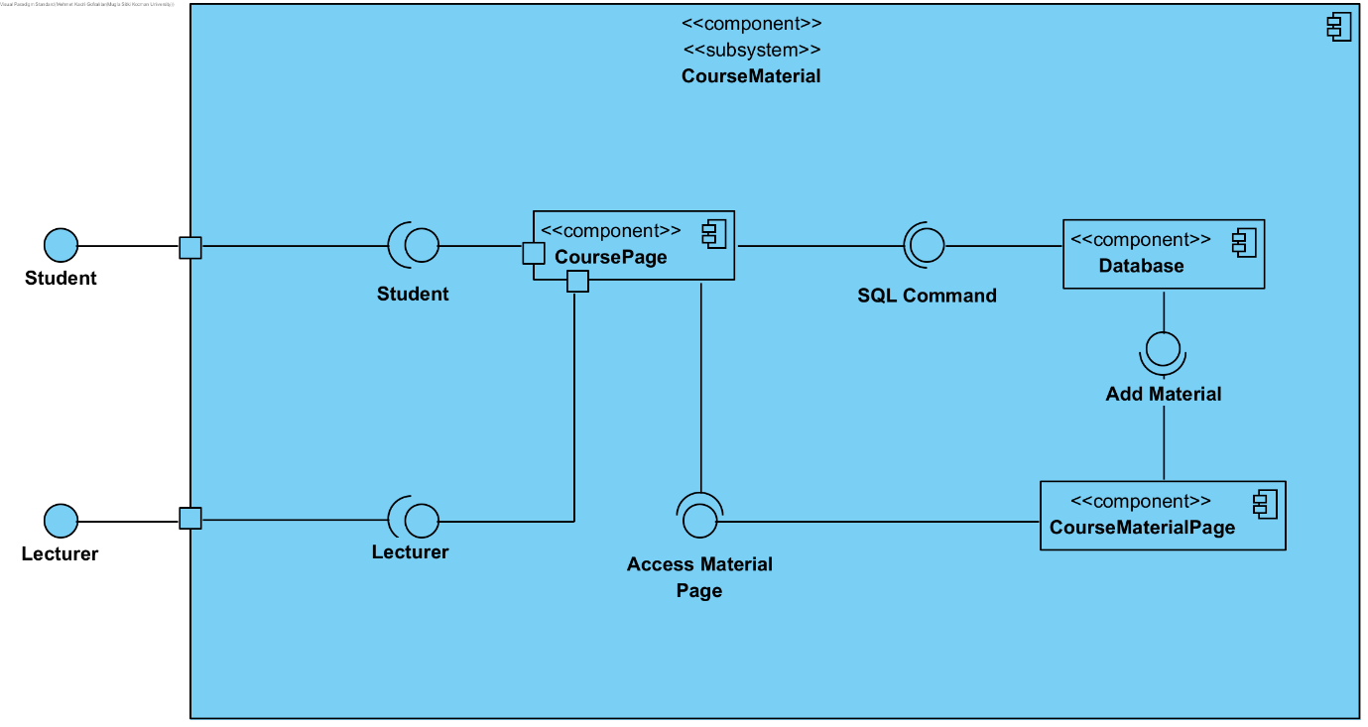
Subsystem Decomposition

Slide 11
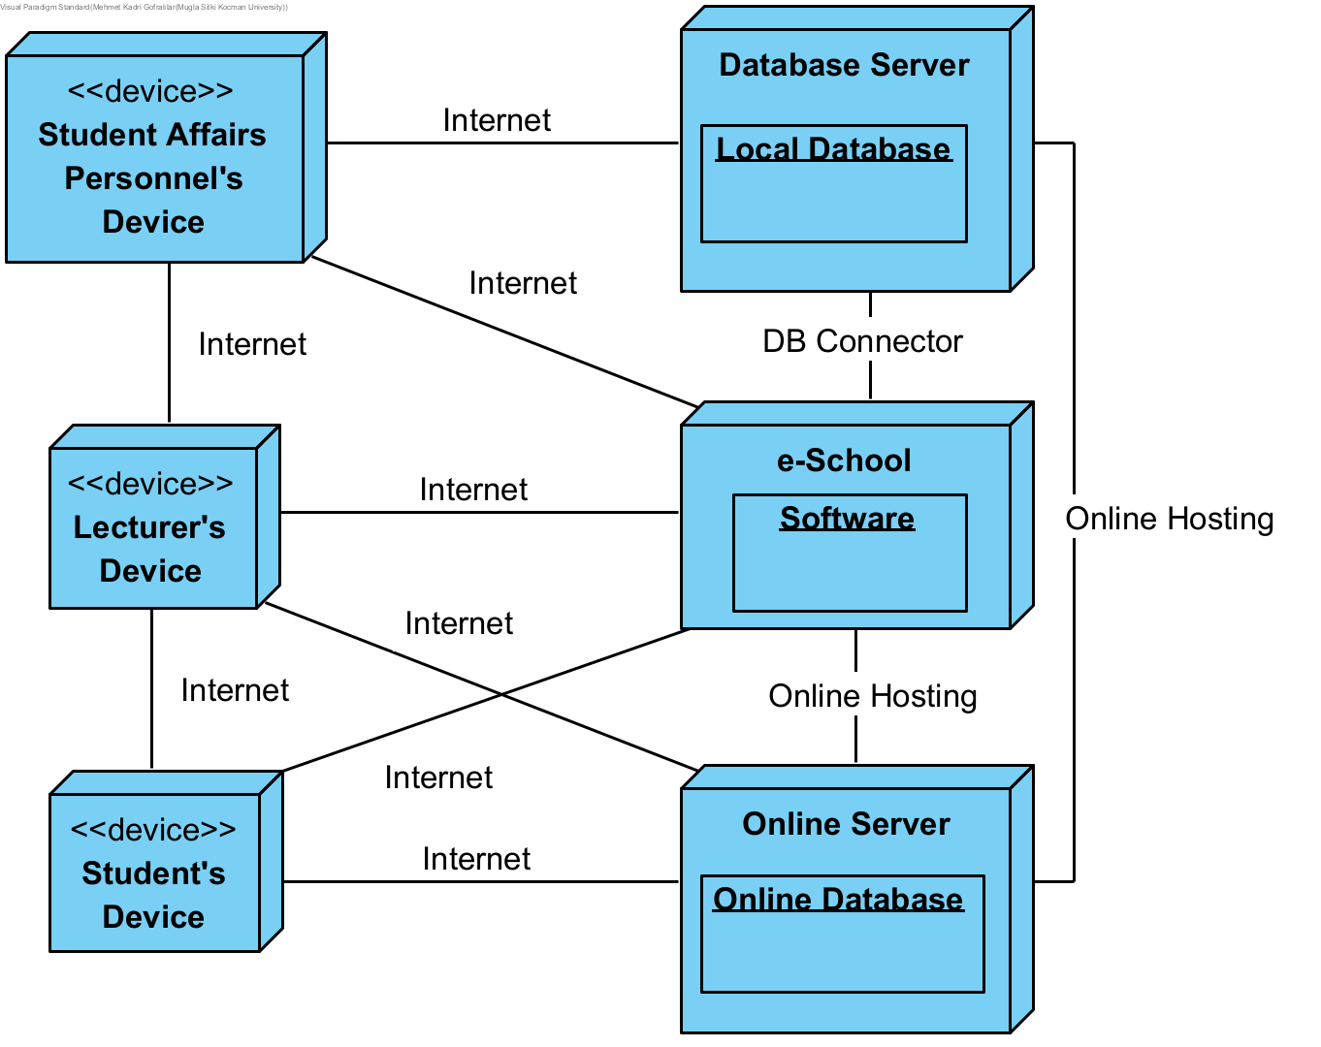
Hardware/Software Mapping

Slide 12
Other Design Concerns
Concurrency
Every action except student lecture registration can be done simultaneously.
Student lecture registration should be taken into consideration since there might be an overlap when there are no vacancies more than one.

Slide 13
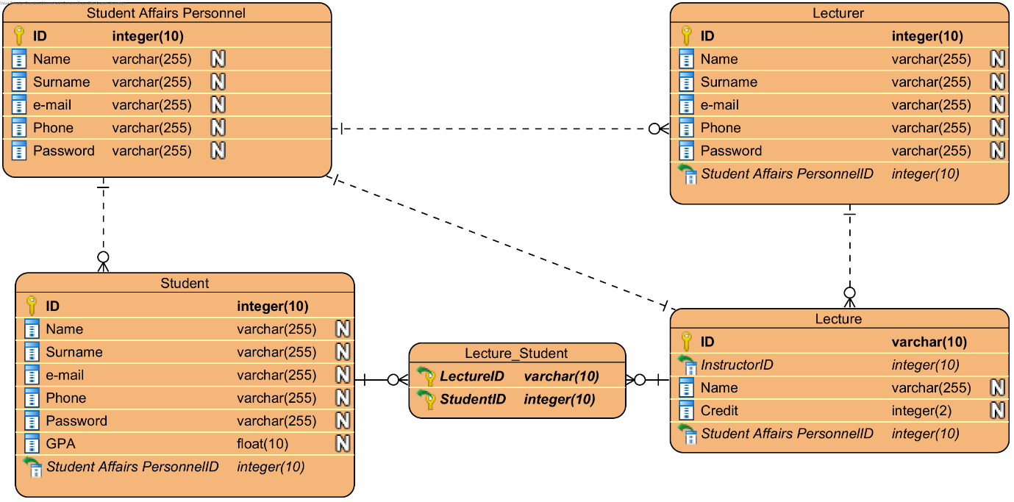
Other Design Concerns
Data Management
RDBMS and cloud storage will be used in this project.

Slide 14
Global Resource Handling
Class/Actor | Student Affairs Personnel | Lecturer | Student
Lecturer | <<create>> assignLecturer()
Student | <<create>> confirmLectureRegisteration() | takeAttendance() startLecture() endLecture() createExam() createAssingnment() uploadCouseMaterial()
Lecture | <<create>> | addGradingMethodToLecture() grade() | registerLecture() attendLecture() uploadAssignment() attendExam() viewLectureMaterials()
Document | confirmDocument() | <<create>> | <<create>>
Grading Methods |  | <<create>> | getGrades()

Slide 15
Boundary Conditions
Initialization
What data need to be accessed at startup time?
User sign in credentials is accessed at startup time.
What services have to be registered?
Online hosting services and database servers are needed.
What does the user interface do at startup time?
A login page is displayed.

Slide 16
Boundary Conditions
Termination
Are single subsystem is allowed to terminate?
Single subsystems are allowed to terminate in case of an error.
Are subsystems notified if a single subsystem terminates?
Subsystems are notified according to the context, such as terminating an exam.
How are updates communicated to the database?
In case of an update through software, database is updated via DB Connector. Also student affairs personnel can update database directly.

Slide 17
Boundary Conditions
Failure
How does the system behave when a node or communication link fails?
System kicks the user and notifies the user when the system is back online.
How does the system recover from failure?
System is recovered using the data from latest back-up.

